Slide 1




Blockchain-Based Energy Accounting System
(23R11A66B4) Dhanush Chintam - Backend
(23R11A66F6) A.S.Varshitha - Frontend
(23R11A66G5) Chitneni Ananya - Frontend
Duration: Summer Internship 2025

Slide 2




Problem Statement
Old energy tracking systems store data in separate places, take too long to update or match records, and make it hard for users to see what's really happening which leads to delays, confusion, and wasted effort.
Why it matters?
With the rise of renewable energy and decentralized grids, there is a growing need for a secure, real-time, and tamper-proof way to track energy generation, usage, and billing.

Slide 3
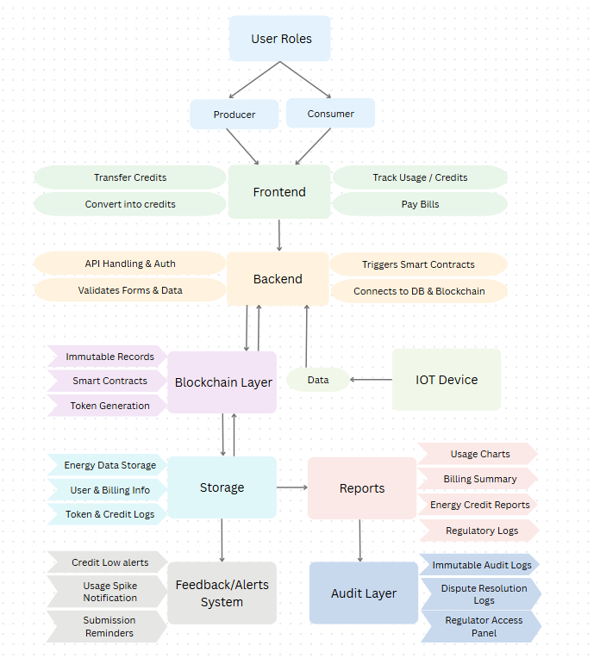

Solution Overview
Our Approach:
We designed a web-based platform that records energy data from IoT devices, stores it on a blockchain via smart contracts, and provides real-time insights and reports to consumer and producer.

Slide 4
Key Features/Functionality
⚡ Credit System
📖 Immutable Ledger
💸 ETH Payments
🔁 P2P Credit Transfers
🌐 Unified User Dashboard
🧠 Intuitive UI Design

Slide 5
Tech Stack:
Frontend: React.js+ Tailwind css
Backend: Node.js + Express
Database: MySQL
Blockchain: Ethereum ( Smart Contracts)
Other: Figma/Canva (Design)

Slide 6
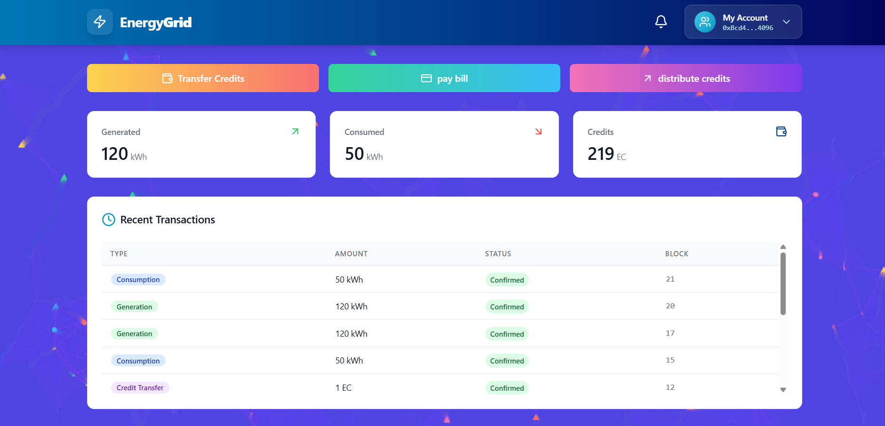

Demo

Slide 7
Learnings
Challenges
• Worked with decentralized architecture & blockchain
• Deployed smart contracts and integrated APIs
• Connecting backend to web frontend
• Designed user flows in Figma
• Smart contract deployment & gas optimization
• Real-time IoT data syncing
• Visualizing complete user flow

Slide 8
Future Scope
Plan to develop a web application for convenient access
Aim to enhance the system for broader scalability
Layer-2 solutions (Polygon, zk-Rollups)
Explore opportunities for global integration and adoption
Project Status: Functional prototype, ready for pilot testing with simulated data.

Slide 9
Thank You

